Slide 1
.NET Standard a .NET Core
Ing. Jan Janoušek

Slide 2
.NET Core
It is not a new version of the .NET Framework!
Innovation - backward compatibility is not addressed.
Opensource
Multiplatformity
Modularity
.NET Core ≠ .NET Framework
Does not mean the end of the .NET Framework (yet)

Slide 3



WPF
Windows Forms
ASP.NET (4.X)
ASP.NET Core
Universal Windows Apps
.NET Framework 4.6
.NET Core
Common
Runtime Components
Compilers
NuGet packages
Next gen JIT (RyuJIT)
SIMD
Languages innovation
.NET Compiler Platform
.NET Core 5 Libraries
.NET Framework 4.6 Libraries

Slide 4
Not everything works on all platforms!
WPF
Windows Forms
WebForms
Binary serialization
Everything related to the Windows. For example:
System.Drawing (depends on Windows GDI+)
Registry
ACL
Performance Counters
………..

Slide 5
Supported OS
Windows
Windows 7 SP1+, 8.1
Windows 10 Client
Server 2008 R2 SP1+
Server 2016 (incl. Nano)
macOS
Sierra (10.12+)
High Sierra (10.13)
Linux
RHEL 6,7
Fedora 27,28
Centos 7
Debian 9,8.7+
Ubuntu 18.04, 17.10, 16.04, 14.04
Linux Mint 17, 18
openSUSE 42.3+
Oracle Linux 7
SUSE Enterprise Linux 12 SP2+
Alpine Linux 3.7+

Slide 6
.NET Standard
Specifies which APIs must be implemented / supported.
Current (before .NET Standard) status - libraries written for the .NET Framework, .NET Compact Framework, .NET Core, Xamarin, etc. are not compatible with each other.
Future status - libraries will be written for a certain version of the .NET Standard = they will be compatible with anything that supports at least the version of the standard for which they are written.

Slide 7
.NET – code reusability
.NET FRAMEWORK
.NET CORE
XAMARIN
APP
MODELS
WPF
Windows Forms
UWP
iOS
Android
ASP.NET
ASP.NET Core
OS X
BASE
LIBRARIES
.NET Framework BCL
.NET Core BCL
Mono BCL
Notes:
Notes: Even if we are reusing a lot across components (especially with the open sourcing last year), the reality is that each platform has its own implementation of the base libraries.
Note: .NET Framework BCL and Mono BCL are the same APIs, different implementation. .NET Core “Core Library” is a similar set of APIs, but different.

Slide 8
Problems
Problematic reuse of knowledge
It is necessary to know the 3 + 1 type of basic libraries.
Problematic code reuse
The set of libraries that are common across platforms is minimal.
Problematic innovation
Each new library needs to be implemented for each platform separately.

Slide 9
.NET Standard
.NET FRAMEWORK
.NET CORE
XAMARIN
APP
MODELS
WPF
Windows Forms
UWP
iOS
Android
ASP.NET
ASP.NET Core
OS X
BASE
LIBRARIES
.NET Standard
Notes:
Notes: Even if we are reusing a lot across components (especially with the open sourcing last year), the reality is that each platform has its own implementation of the base libraries.
Note: .NET Framework BCL and Mono BCL are the same APIs, different implementation. .NET Core “Core Library” is a similar set of APIs, but different.

Slide 10
Benefits
Knowledge reuse
You only need to know 1 set of basic libraries.
Code reuse
The set of libraries that are common across platforms is large.
Innovation
.NET Standard-targeted code can run across platforms.

Slide 11
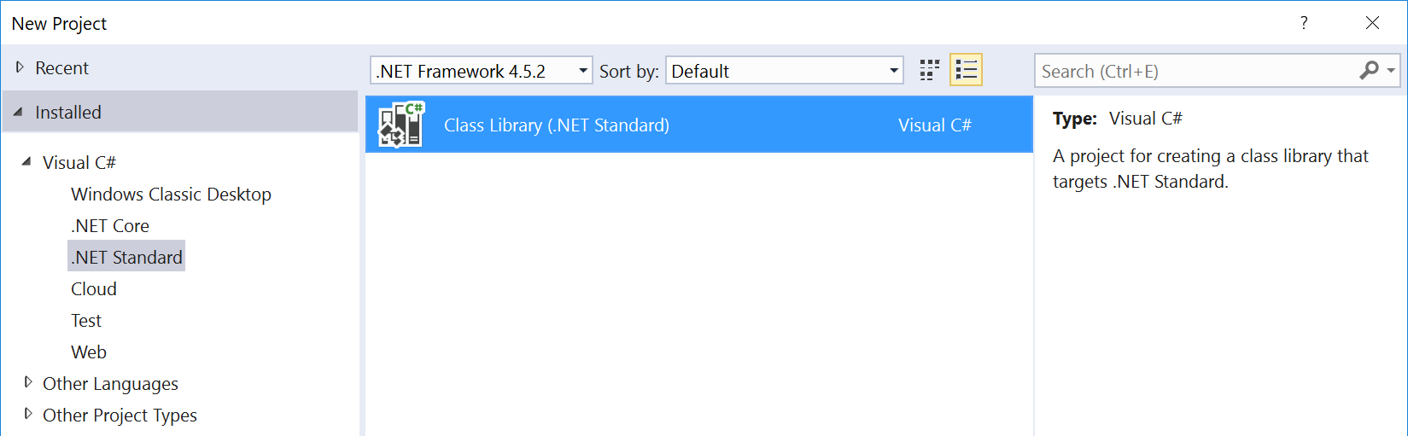
What is .NET Standard?
.NET Standard is specification.
A set of APIs that must be implemented by all .NET platforms.
.NET Standard
.NET Framework
.NET Core
Xamarin
~
~
HTML specification
Browser

Slide 12
Versions of .NET Standard
Higher versions include all APIs from lower versions.
Projects targeting version X.Y can reference libraries and projects targeting any version between 1.0 and X.Y
A particular .NET platform implements a specific version of the .NET Standard
From such a platform, it is possible to reference libraries that target the .NET Standard up to a given version.
2.0
1.6
1.3
1.0

Slide 13
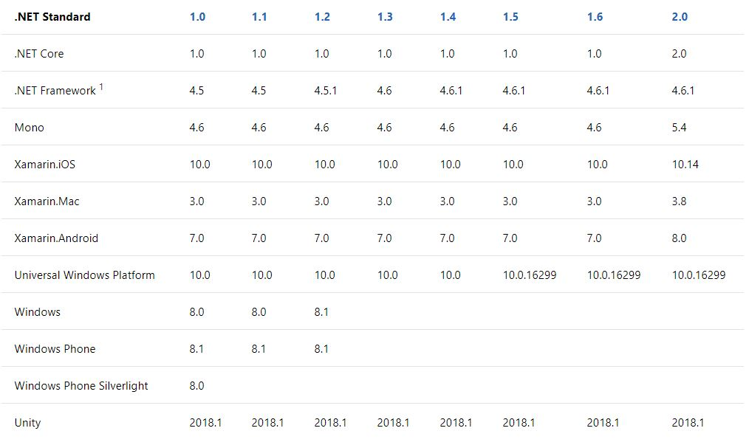
Versions of .NET Standard

Slide 14
Which version of .NET Standard to target?
Higher version = wider set of APIs.
Lower version = wider support (support for multiple platforms).
Lower version
Higher version
Better support
More API

Slide 15
Which version of .NET Standard to target?
The lowest possible version that includes the API you need.

Slide 16
How does .NET Standard work?
The .NET Standard is represented
NuGet is a NetStandard.Library package that contains the netstandard.dll assembly
At the time of build
The .NET Standard bridges references to existing types within the .NET Framework and PCL using "type forwarding".
While running
Each platform provides its own implementation for netstandard.dll. It is used for "type forwarding".

Slide 17
How does .NET Standard work?
YOUR .NET APPLICATION
FRAMEWORK ASSEMBLIES
TYPE
FORWARDING
YOUR .NET STANDARD-BASED CLASS LIBRARY
NETSTANDARD.DLL
This happens when you load .NET Standard-based library

Slide 18
What can be referenced within the .NET Standard?
.NET FRAMEWORK
.NET CORE
XAMARIN
Legend
My Standard Library 2.x
Is able to reference
Application Type
Via Portability
.NET Standard Library
Portable Class Library
.NET Framework Library
Via Compatibility Shim

Slide 19
Platform dependent API
The .NET Standard contains (almost) only APIs that work on all platforms.
There is a small set of APIs that do not work on all platforms. If used on an unsupported platform, a PlatformNotSupportedException exception is thrown
Platform-specific APIs are distributed as "additional libraries".
Examples: Registry, Reflection Emit, Access Control, Windows Identity

Slide 20
Platform dependent API
YOUR .NET APPLICATION
FRAMEWORK ASSEMBLIES
YOUR .NET STANDARD-BASED CLASS LIBRARY
SUPPORTED EXTENSION
TYPE
FORWARDING
EXCEPTION
UNSUPPORTED EXTENSION
This happens when you load .NET Standard-based library with platform-specific extensions

Slide 21
Microsoft.Windows.Compatibility
NuGet package with Windows-specific APIs.
Support for 20,000+ APIs that are not part of .NET Core (because they depend on Windows).

